Slide 1
Tournament Database
This is a simple tournament database where we use a web site as front and retrieve data from database as well as data using php

Slide 2
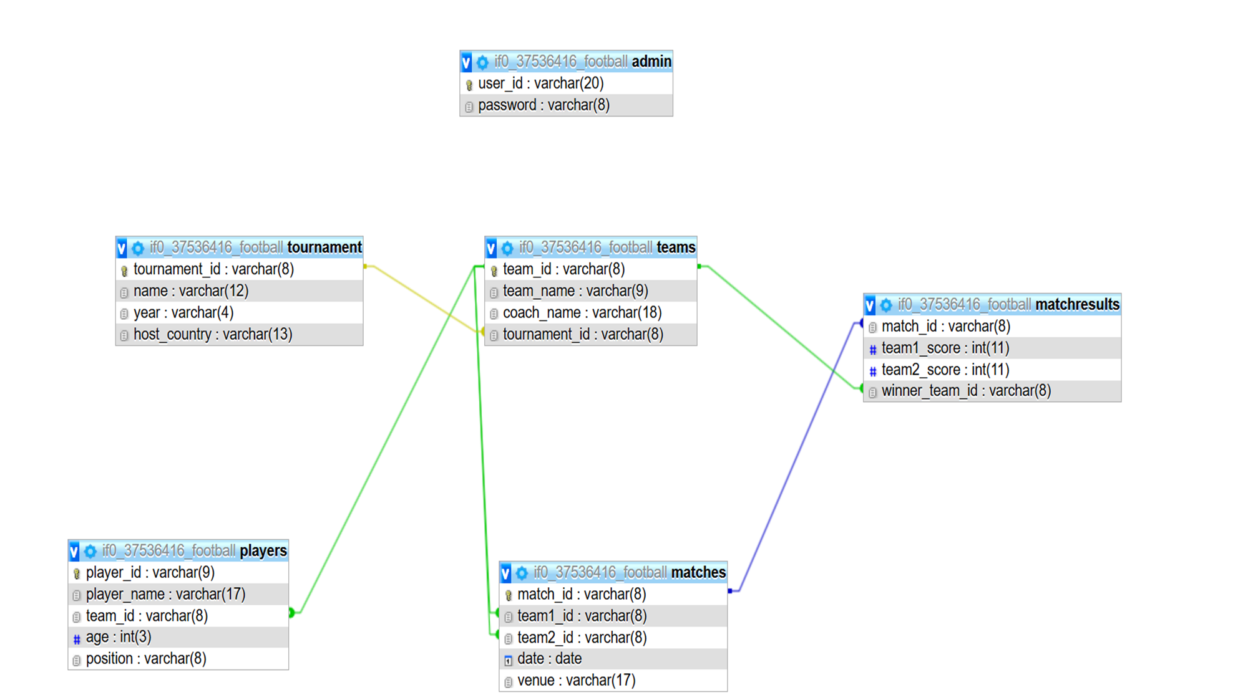

Slide 3
Admin Login Portal
Secure Access
Match Management
Data Control
Restricted entry for authorized administrators only.
Add, modify match results and scores.
Centralized system for maintaining competition integrity.

Slide 4
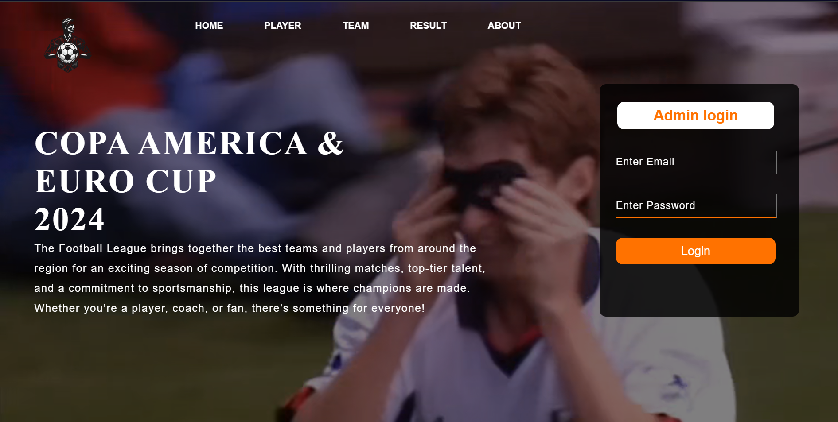

Slide 5



Player Details Page
Player ID Input
Unique identifier for each player.
Database Query
Retrieves player information based on ID.
Display Details
Presents comprehensive player profile and team.

Slide 6
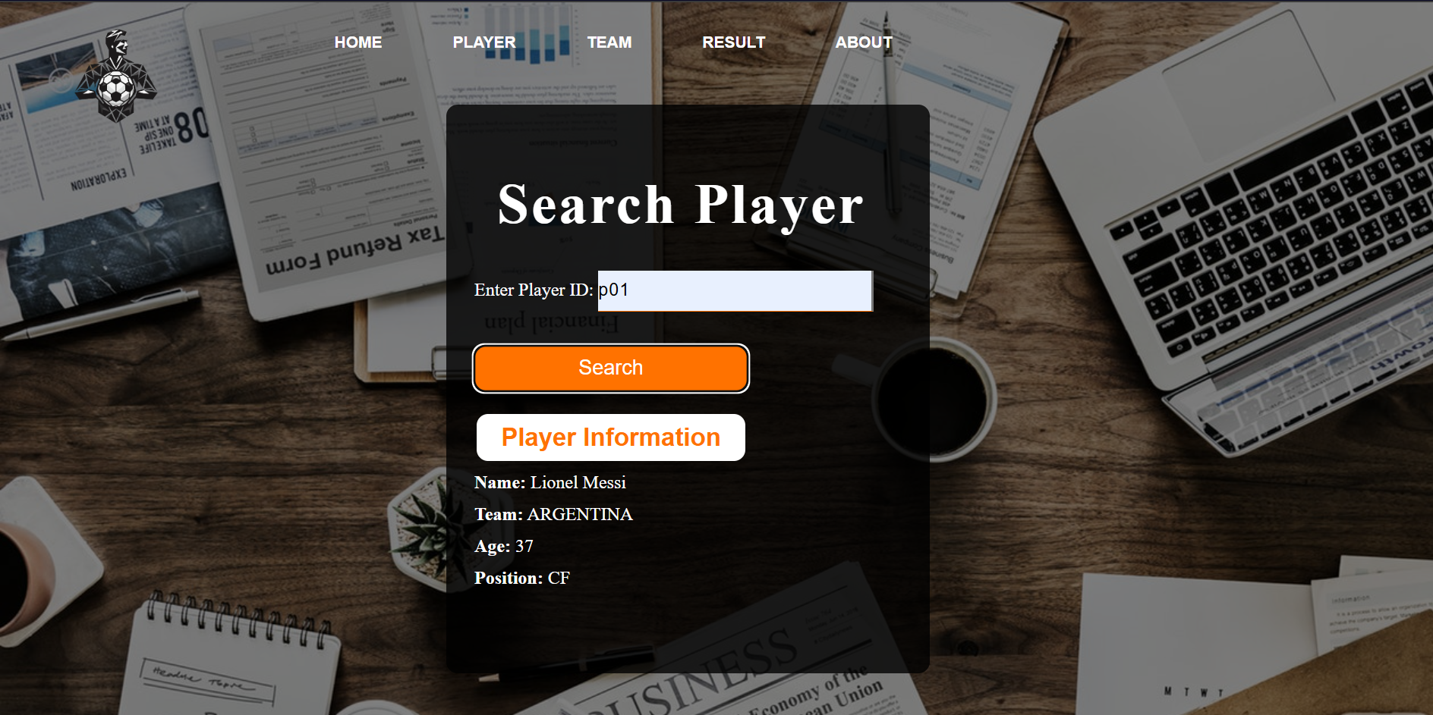

Slide 7


Team Id Input
Used to identify each team
Team details
Database Query
Retrieves player information based on ID.
Then team page which show team information
and their coach with their unique team id
Display Details
Presents comprehensive team profile

Slide 8
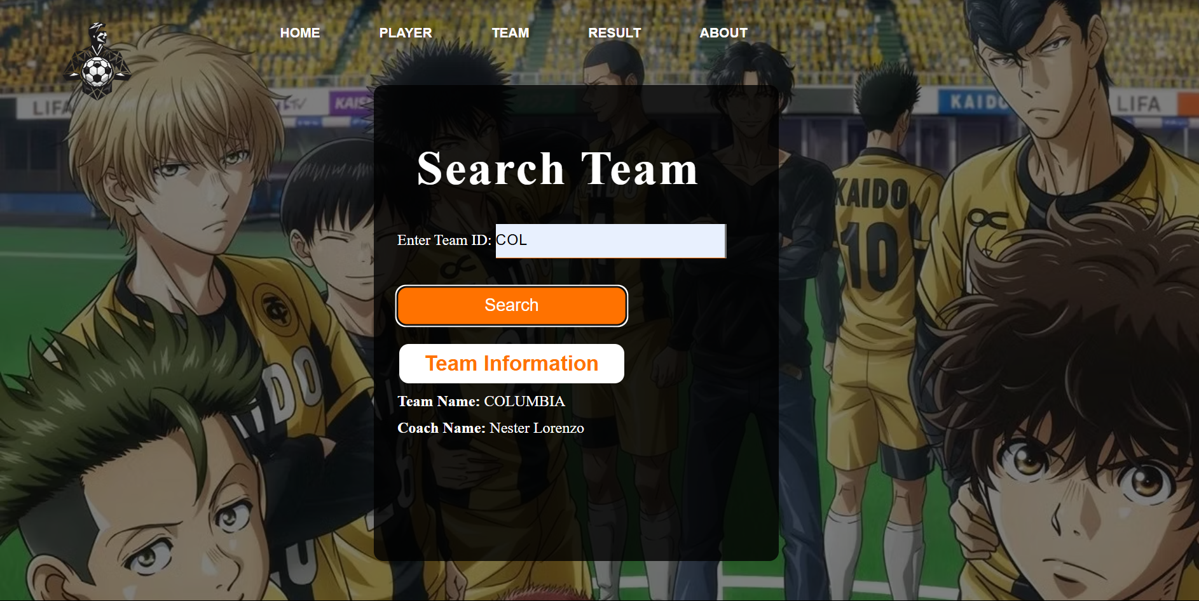

Slide 9
Match Results Page
Display match outcomes with unique identifiers.
Showcase winning teams and their corresponding IDs.

Slide 10
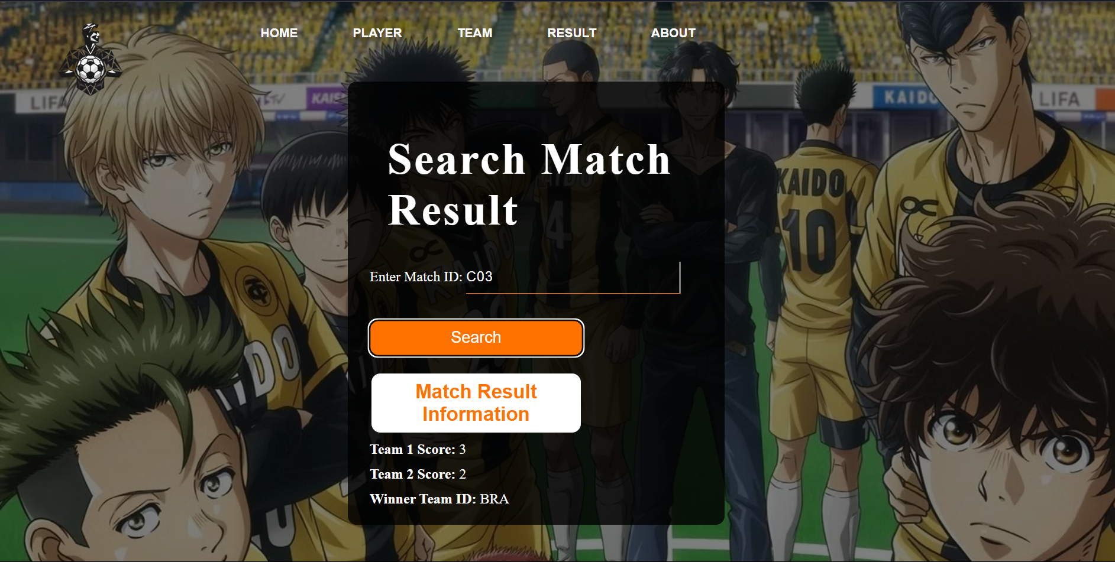

Slide 11
About page
This about page provides an overview of the site. We are committed to providing our users with a convenient and user-friendly platform to access the information they need. We believe that everyone should have access to reliable and up-to-date information, and we strive to make that happen through our platform. We also believe in the importance of data privacy and security. We have implemented robust security measures to protect our users' information and ensure its confidentiality. We are committed to continuously improving our platform to provide the best possible experience for our users.

Slide 12


Slide 13
Match Result Page
1
Admin Login
Secure authentication for authorized access.
2
Score Entry
Input team scores accurately and efficiently.
3
Winner Declaration
Designate winning team based on scores.
4
Data Validation
Ensure score integrity and prevent errors.

Slide 14
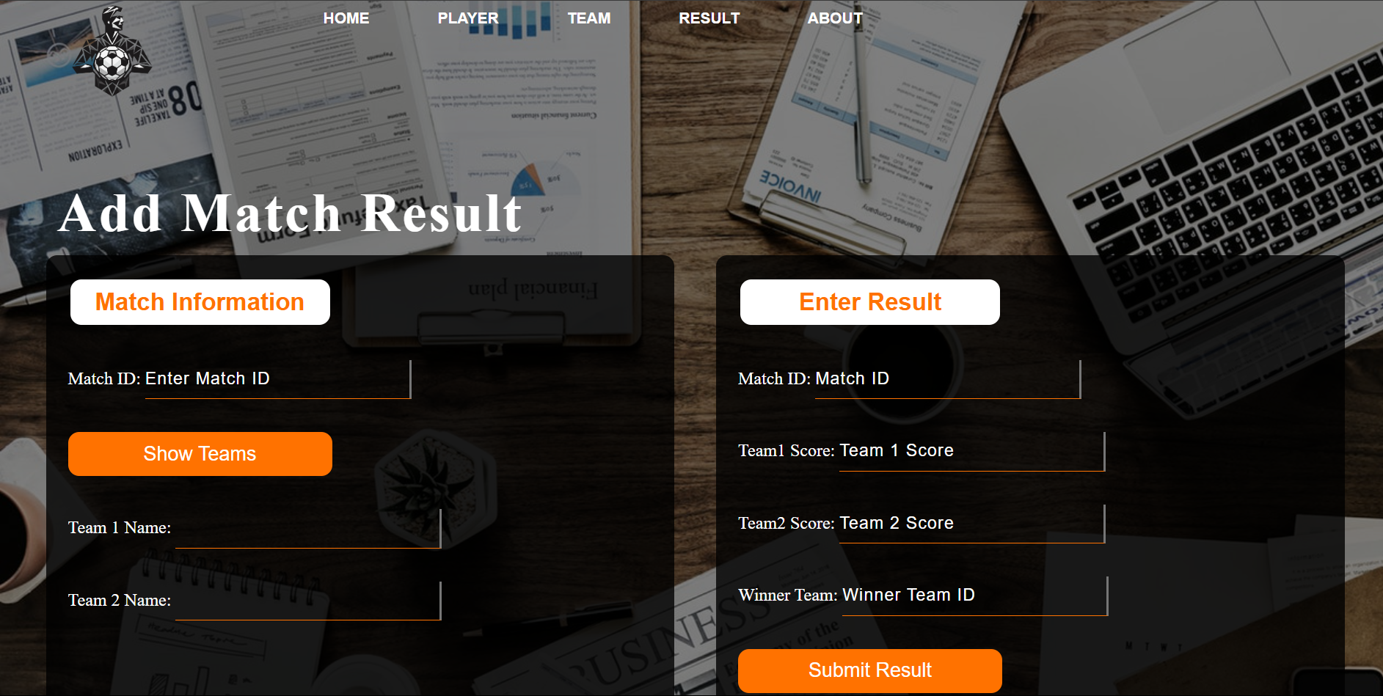

Slide 15
THANK YOU

